Slide 1
Announcements
Cool things in the world of Angular
April, 2014
http://goo.gl/ckOEsn

Slide 2

7 AngularJS Releases!
AngularJS 1.2.10
through 1.2.16
Highlights:
293 PRs and issues closed!
ngModelOptions: custom triggers and debounce of ngModel updates
Support for $observer deregistration
input supports new types: date, time, datetime-local, month, week
$animate: animate dirty, pristine, valid, invalid for form/fields
filterFilter: support deeply nested predicate objects
AngularJS 1.3.0-beta.2
through 1.3.0-beta.5

Slide 3
5 AngularDart Releases!
AngularDart 0.9.10
Highlights:
70 PRs and issues closed!
New tagging-style compiler
EventHandler Add support for on-* style events

Slide 4
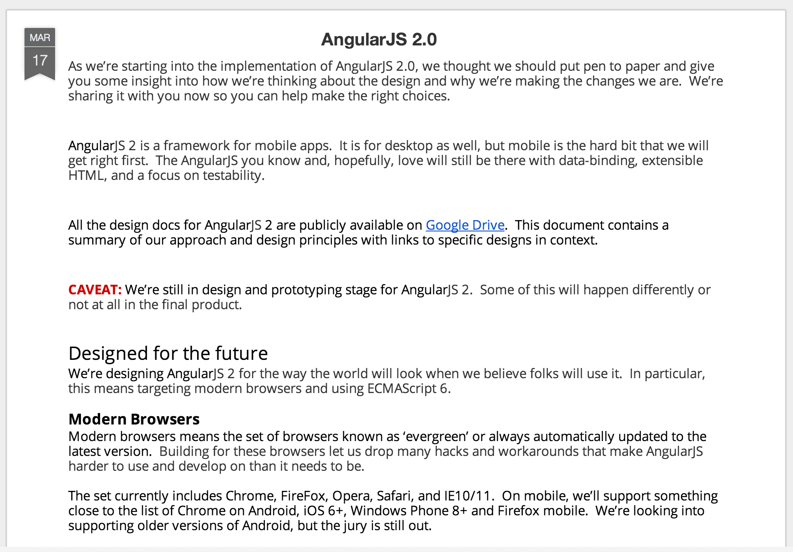
2.0 on blog.angularjs.org

Slide 5
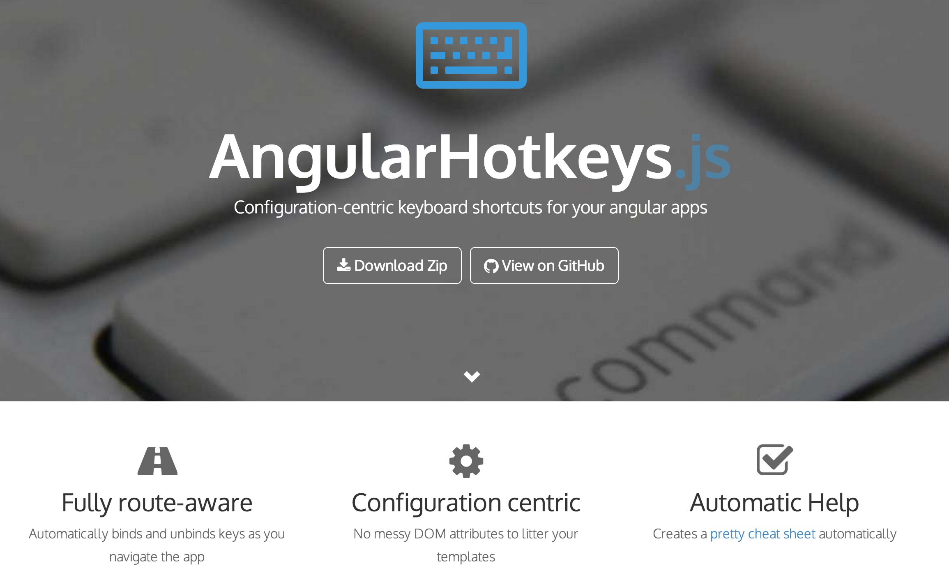
AngularHotkeys.js
http://chieffancypants.github.io/angular-hotkeys/

Slide 6
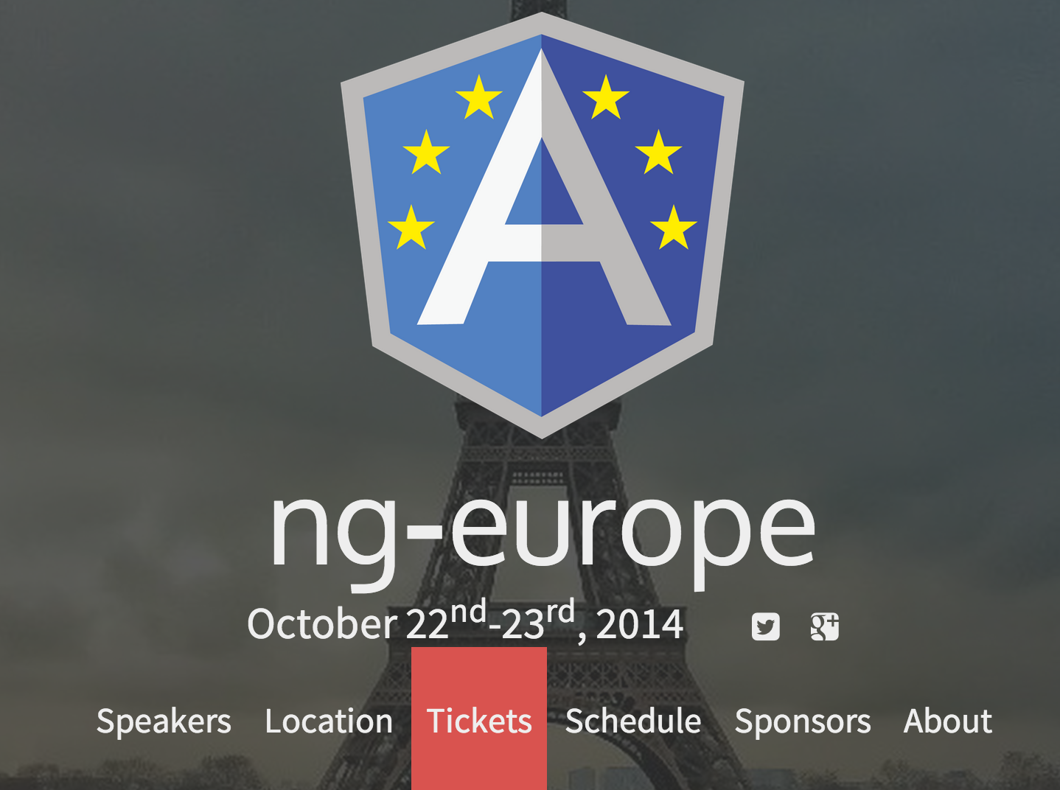
ngEurope announced!
ngeurope.org

Slide 7
Thanks!
http://goo.gl/ckOEsn

